Slide 1

Reliability Testing of iroh-gossip in Realistic Network Environments
Andrea Seehuber
New Trends for Local and Global Interconnects for P2P Applications
University of Basel, 29.10.2025

Slide 2

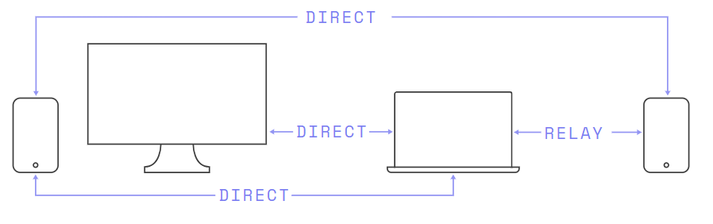
Recap: What is iroh?
Library that can be used to establish secure P2P connections
based on QUIC as network protocol
  uses UDP as transport protocol
  can use TLS for cryptographic security
currently used by DeltaChat, Shaga, DumbPipe (for example)

Slide 3
Recap: What is iroh?
Endpoint: main API for establishing connections
Discovery: service that resolves EndpointID to a relay URL or a P2P connection (DNS or local)
Router: implements the accept loop and directs incoming connections to the correct protocol (via ALPN)
uses relay servers to establish secure P2P connections (also fallback if no P2P possible)
direct P2P connection possible via Tickets

Slide 4

Recap: The iroh-gossip
P2P protocol for managing neighbourhoods in a dynamic network
list of peers is devided into subsets: active view and passive view
regularly checks active neighbours and replaces from passive list if no longer active
peers randomly exchange entries from their passive views
HyParView (Hybrid Partial View)

Slide 5
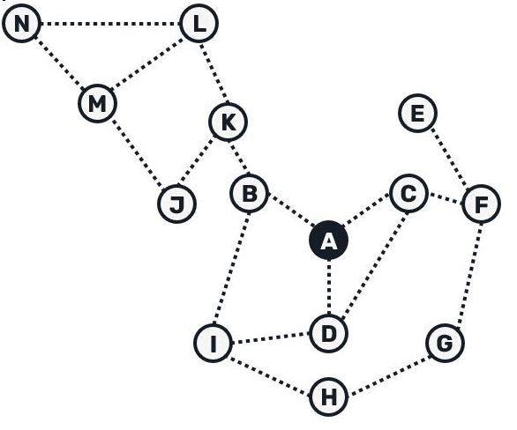
Recap: The iroh-gossip
tow gropus of neighbours:
eager peers: receive message immediately
lazy peers: only receive hash of the message
advantages:
high reliability: every node ultimately receives every message
efficiency: only a few messages contain the full content
self-optimising: paths with low latency are used preferentially
PlumTree (Push-Lazy-Update-Multicast)

Slide 6
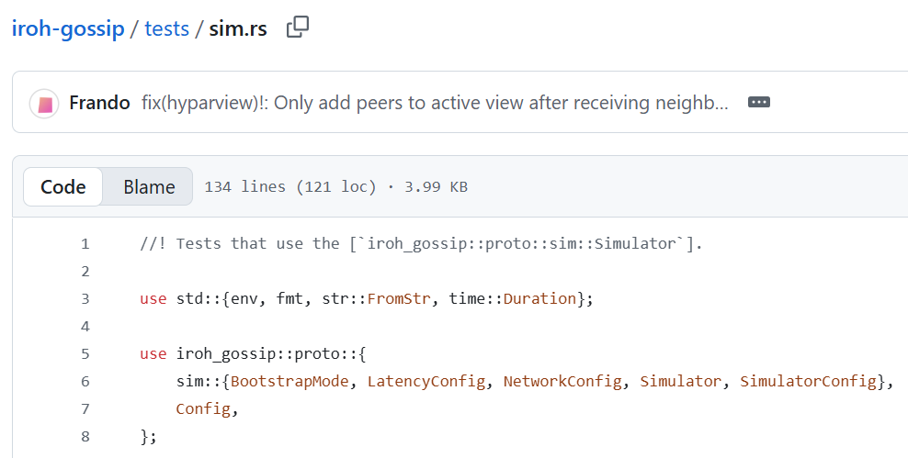
iroh-gossip testing
big_hyparview: checks whether all peers have neighbours after bootstrap
big_single_sender: measures delivery rate, duplicates, efficiency
big_multiple_sender: stress test, measures propagation and deduplication
big_burst: each peer sends many messages; measures scalability and performance under high load
What has already been done?

Slide 7

iroh-gossip testing
but …
Tests run entirely within a simulator,
i. e. without a real network!
What has already been done?

Slide 8

iroh-gossip testing
Possible questions to answer:
How robust is the gossip against network failures, i. e. packet loss, latency, interruptions?
How much does discovery (direct vs. relay) affect delivery rates?
How does the system converge when peers fail or reconnect?
What could be done?

Slide 9
iroh-gossip testing
Possible use-cases:
Local LAN, Direct Discovery
  no injection of network disruptions
  no relay discovery active
Relay-Assisted Discovery (NAT Simulation)
  same as UC1 but alternative relay discovery
Relay-Assisted Discovery, Degraded
  same as UC2 but injection of delay and packet loss
Churn and Recovery
  same as UC1 or UC3 but disconnect/rejoin of peers
What could be done?

Slide 10
iroh-gossip testing
Possible metrics:
delivery ratio (DR): received vs. sent messages
duplicate rate (DuR): unique received messages
end-to-end-delay (E2E): average delivery time or per message received
convergence time (CT): time until all peers receive all messages
peer reachability (PR): reachable vs. connected peers
reconnect time (RT): time until first received message after reconnect
What could be done?

Slide 11
iroh-gossip testing
Comparison | Constant parameters | Variable | Metrics | Expected trends
UC1 vs. UC2 | no network impairments same no. of peers, message rate and payload | discovery method | DR, DuR, E2E, CT, PR | relay discovery improves DR and PR; E2E and CT worsens
UC2 vs. UC3 | relay enabled same no. of peers, message rate and payload | network quality | DR, DuR, E2E, CT, PR | under degraded network: DR decreases, DuR increases, E2E and CT grow, PR remains stable
UC1 vs. UC3 | same no. of peers, message rate and payload | discovery type + network quality | DR, DuR, E2E, CT, PR | largest performance gap expected
UC1 vs. UC4 | no network impairments same no. of peers, message rate and payload same discovery type | churn under direct discovery | DR, DuR, CT, RT, PR | during disconnections, DR drops and CT rises; after rejoin, peers recover but measurable RT
UC2 vs. UC4 | no network impairments same no. of peers, message rate and payload same discovery type | churn under relay-assisted discovery | DR, DuR, CT, RT, PR | with relay, RT decreases and DR recoveres more quickly compared to direct discovery

Slide 12
iroh-gossip testing
so …
What really makes sense?
What is feasible?
What could be done?

